Slide 1

Hospital Database Analysis
A Comprehensive MySQL-Based Analysis of Hospital Performance, Cost, and Patient Outcomes
By SUPRATIM MAITY

Slide 2

Project Overview
Analytical Focus
Core Objective
Study of hospital data examining patient demographics, treatment outcomes, and cost efficiency using MySQL queries.
Uncover insights into operational effectiveness, patient care quality, and performance improvement areas.

Slide 3






Business Objectives
Patient Demographics
Cost Efficiency
Recovery Trends
Analyze health conditions and patient profiles
Evaluate treatment costs and operational efficiency
Monitor readmission and recovery patterns
Patient Satisfaction
Risk Factors
Strategic Decisions
Measure service quality and satisfaction metrics
Identify improvement opportunities
Support hospital management planning

Slide 4

Database Design
Database Creation & Selection:
CREATE DATABASE IF NOT EXISTS hospital_analysis; USE hospital_analysis;
Table Creation:
CREATE TABLE patients ( Patient_ID INT PRIMARY KEY, Age INT, Gender ENUM('Male', 'Female'), `Condition` VARCHAR(100), `Procedure` VARCHAR(100), Cost DECIMAL(10,2), Length_of_Stay INT, Readmission ENUM('Yes', 'No'), `Outcome` ENUM('Recovered', 'Stable'), Satisfaction INT );

Slide 5





Analytical Queries and Insights
Deep insights into hospital performance patterns, treatment outcomes, and patient care metrics across multiple dimensions.
Demographics Analysis
Patient profiles and health conditions
Treatment Patterns
Procedures and medical interventions
Quality Metrics
Satisfaction and readmission trends
Operational Efficiency
Cost management and resource optimization

Slide 6
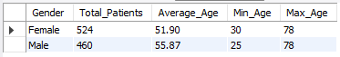
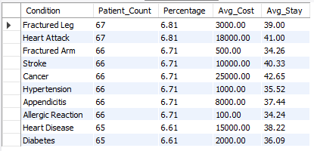
1. Patient Demographics Overview
Purpose: Summarize patient distribution by gender, showing total count, average, minimum, and maximum age per gender.
SELECT
Gender,
COUNT(*) AS Total_Patients,
ROUND(AVG(Age), 2) AS Average_Age,
MIN(Age) AS Min_Age,
MAX(Age) AS Max_Age
FROM patients
GROUP BY Gender;
OUTPUT →
2. Condition Prevalence Analysis
Purpose: Identify the most common medical conditions and their average treatment cost and hospital stay duration.
SELECT
`Condition`,
COUNT(*) AS Patient_Count,
ROUND((COUNT(*) * 100.0 / (SELECT COUNT(*) FROM patients)), 2) AS Percentage,
ROUND(AVG(Cost), 2) AS Avg_Cost,
ROUND(AVG(Length_of_Stay), 2) AS Avg_Stay
FROM patients
GROUP BY `Condition`
ORDER BY Patient_Count DESC;
OUTPUT →

Slide 7
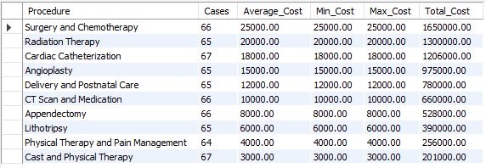
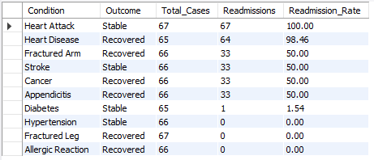
3. Cost Analysis by Procedure
Purpose: Compare procedures by total, average, and range of costs.
SELECT
`Procedure`,
COUNT(*) AS Cases,
ROUND(AVG(Cost), 2) AS Average_Cost,
ROUND(MIN(Cost), 2) AS Min_Cost,
ROUND(MAX(Cost), 2) AS Max_Cost,
ROUND(SUM(Cost), 2) AS Total_Cost
FROM patients
GROUP BY `Procedure`
ORDER BY Average_Cost DESC;
OUTPUT →
4. Readmission Rate Analysis
Purpose: Measure how often patients are readmitted for each condition and outcome category.
SELECT
`Condition`,
`Outcome`,
COUNT(*) AS Total_Cases,
SUM(CASE WHEN Readmission = 'Yes' THEN 1 ELSE 0 END) AS Readmissions,
ROUND((SUM(CASE WHEN Readmission = 'Yes' THEN 1 ELSE 0 END) * 100.0 / COUNT(*)), 2) AS Readmission_Rate
FROM patients
GROUP BY `Condition`, `Outcome`
HAVING COUNT(*) > 10
ORDER BY Readmission_Rate DESC;
OUTPUT →

Slide 8
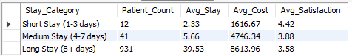
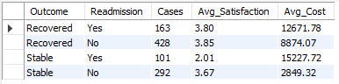
5. Length of Stay vs Cost
Purpose: Categorize patients by hospital stay duration and compare their average costs and satisfaction.
SELECT
CASE
WHEN Length_of_Stay <= 3 THEN 'Short Stay (1-3 days)'
WHEN Length_of_Stay <= 7 THEN 'Medium Stay (4-7 days)'
ELSE 'Long Stay (8+ days)'
END AS Stay_Category,
COUNT(*) AS Patient_Count,
ROUND(AVG(Length_of_Stay), 2) AS Avg_Stay,
ROUND(AVG(Cost), 2) AS Avg_Cost,
ROUND(AVG(Satisfaction), 2) AS Avg_Satisfaction
FROM patients
GROUP BY Stay_Category
ORDER BY Avg_Stay;
OUTPUT →
6. Satisfaction by Outcome & Readmission
Purpose: Correlate recovery outcome and readmission status with patient satisfaction and treatment cost.
SELECT
`Outcome`,
Readmission,
COUNT(*) AS Cases,
ROUND(AVG(Satisfaction), 2) AS Avg_Satisfaction,
ROUND(AVG(Cost), 2) AS Avg_Cost
FROM patients
GROUP BY `Outcome`, Readmission
ORDER BY `Outcome`, Readmission;
OUTPUT →

Slide 9
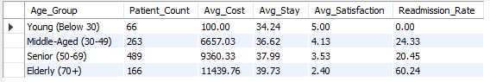
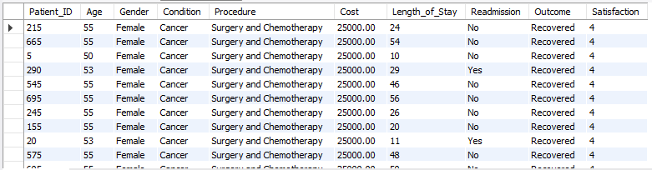
7. Age Group Analysis
Purpose: Segment patients into age groups to compare cost, length of stay, satisfaction, and readmission rates.
SELECT
CASE
WHEN Age < 30 THEN 'Young (Below 30)'
WHEN Age < 50 THEN 'Middle-Aged (30-49)'
WHEN Age < 70 THEN 'Senior (50-69)'
ELSE 'Elderly (70+)'
END AS Age_Group,
COUNT(*) AS Patient_Count,
ROUND(AVG(Cost), 2) AS Avg_Cost,
ROUND(AVG(Length_of_Stay), 2) AS Avg_Stay,
ROUND(AVG(Satisfaction), 2) AS Avg_Satisfaction,
ROUND((SUM(CASE WHEN Readmission = 'Yes' THEN 1 ELSE 0 END) * 100.0 / COUNT(*)), 2) AS Readmission_Rate
FROM patients
GROUP BY Age_Group
ORDER BY FIELD(
Age_Group,
'Young (Below 30)',
'Middle-Aged (30-49)',
'Senior (50-69)',
'Elderly (70+)'
);
OUTPUT →
8. High-Cost Patients
Purpose: Identify patients whose costs exceed the average treatment cost across all patients.
SELECT
Patient_ID, Age, Gender, `Condition`, `Procedure`, Cost, Length_of_Stay, Readmission, `Outcome`, Satisfaction
FROM patients
WHERE Cost > (SELECT AVG(Cost) FROM patients)
ORDER BY Cost DESC
LIMIT 50;
OUTPUT →

Slide 10
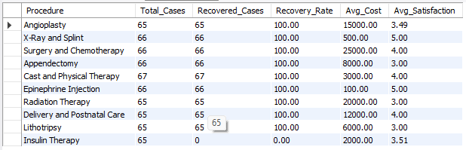
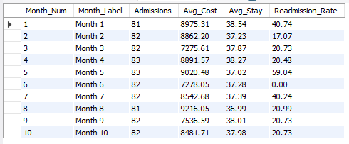
9. Procedure Effectiveness
Purpose: Measure recovery rates and satisfaction levels for each type of medical procedure.
SELECT
`Procedure`,
COUNT(*) AS Total_Cases,
SUM(CASE WHEN `Outcome` = 'Recovered' THEN 1 ELSE 0 END) AS Recovered_Cases,
ROUND((SUM(CASE WHEN `Outcome` = 'Recovered' THEN 1 ELSE 0 END) * 100.0 / COUNT(*)), 2) AS Recovery_Rate,
ROUND(AVG(Cost), 2) AS Avg_Cost,
ROUND(AVG(Satisfaction), 2) AS Avg_Satisfaction
FROM patients
GROUP BY `Procedure`
HAVING COUNT(*) > 5
ORDER BY Recovery_Rate DESC;
OUTPUT →
10. Monthly Trend (Simulated)
Purpose: Simulate admission and readmission trends by month using a modulo operation on Patient_ID.
SELECT
((Patient_ID % 12) + 1) AS Month_Num,
CONCAT('Month ', ((Patient_ID % 12) + 1)) AS Month_Label,
COUNT(*) AS Admissions,
ROUND(AVG(Cost), 2) AS Avg_Cost,
ROUND(AVG(Length_of_Stay), 2) AS Avg_Stay,
ROUND((SUM(CASE WHEN Readmission = 'Yes' THEN 1 ELSE 0 END) * 100.0 / COUNT(*)), 2) AS Readmission_Rate
FROM patients
GROUP BY Month_Num, Month_Label
ORDER BY Month_Num;
OUTPUT →

Slide 11
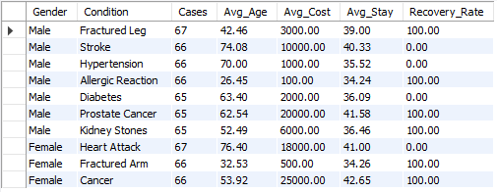
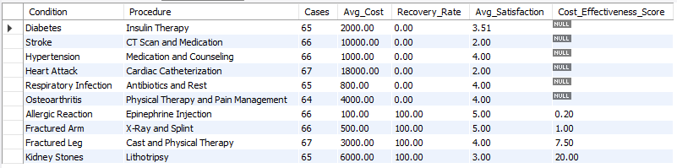
11. Gender-Based Treatment Differences
Purpose: Compare treatment outcomes and costs for each condition across male and female patients.
SELECT
Gender,
`Condition`,
COUNT(*) AS Cases,
ROUND(AVG(Age), 2) AS Avg_Age,
ROUND(AVG(Cost), 2) AS Avg_Cost,
ROUND(AVG(Length_of_Stay), 2) AS Avg_Stay,
ROUND((SUM(CASE WHEN `Outcome` = 'Recovered' THEN 1 ELSE 0 END) * 100.0 / COUNT(*)), 2) AS Recovery_Rate
FROM patients
GROUP BY Gender, `Condition`
HAVING COUNT(*) > 5
ORDER BY Gender, Cases DESC;
OUTPUT →
12. Cost Efficiency
Purpose: Compute a "Cost-Effectiveness Score" combining average cost, recovery rate, and satisfaction.
SELECT
`Condition`,
`Procedure`,
COUNT(*) AS Cases,
ROUND(AVG(Cost), 2) AS Avg_Cost,
ROUND((SUM(CASE WHEN `Outcome` = 'Recovered' THEN 1 ELSE 0 END) * 100.0 / COUNT(*)), 2) AS Recovery_Rate,
ROUND(AVG(Satisfaction), 2) AS Avg_Satisfaction,
ROUND(
AVG(Cost) / NULLIF(
(AVG(Satisfaction) * (SUM(CASE WHEN `Outcome` = 'Recovered' THEN 1 ELSE 0 END) * 100.0 / COUNT(*))),
0),
2) AS Cost_Effectiveness_Score
FROM patients
GROUP BY `Condition`, `Procedure`
HAVING COUNT(*) > 3
ORDER BY Cost_Effectiveness_Score ASC;
OUTPUT →

Slide 12
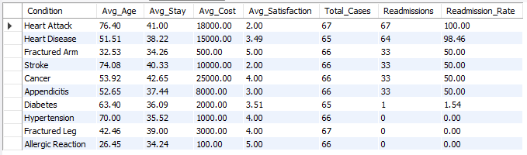
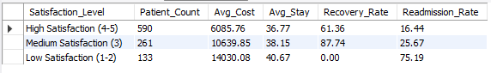
13. Readmission Risk Factors
Purpose: Identify conditions associated with higher patient readmission rates.
SELECT
`Condition`,
ROUND(AVG(Age), 2) AS Avg_Age,
ROUND(AVG(Length_of_Stay), 2) AS Avg_Stay,
ROUND(AVG(Cost), 2) AS Avg_Cost,
ROUND(AVG(Satisfaction), 2) AS Avg_Satisfaction,
COUNT(*) AS Total_Cases,
SUM(CASE WHEN Readmission = 'Yes' THEN 1 ELSE 0 END) AS Readmissions,
ROUND((SUM(CASE WHEN Readmission = 'Yes' THEN 1 ELSE 0 END) * 100.0 / COUNT(*)), 2) AS Readmission_Rate
FROM patients
GROUP BY `Condition`
HAVING COUNT(*) > 10
ORDER BY Readmission_Rate DESC;
OUTPUT →
14. Satisfaction Drivers
Purpose: Group patients by satisfaction levels and analyze their recovery and readmission outcomes.
SELECT
CASE
WHEN Satisfaction >= 4 THEN 'High Satisfaction (4-5)'
WHEN Satisfaction >= 3 THEN 'Medium Satisfaction (3)'
ELSE 'Low Satisfaction (1-2)'
END AS Satisfaction_Level,
COUNT(*) AS Patient_Count,
ROUND(AVG(Cost), 2) AS Avg_Cost,
ROUND(AVG(Length_of_Stay), 2) AS Avg_Stay,
ROUND((SUM(CASE WHEN `Outcome` = 'Recovered' THEN 1 ELSE 0 END) * 100.0 / COUNT(*)), 2) AS Recovery_Rate,
ROUND((SUM(CASE WHEN Readmission = 'Yes' THEN 1 ELSE 0 END) * 100.0 / COUNT(*)), 2) AS Readmission_Rate
FROM patients
GROUP BY Satisfaction_Level
ORDER BY FIELD(
Satisfaction_Level,
'High Satisfaction (4-5)',
'Medium Satisfaction (3)',
'Low Satisfaction (1-2)'
);
OUTPUT →

Slide 13
15. Performance Dashboard
Purpose: Provide an overall hospital summary and a high-cost patient comparison for executive reporting.
SELECT
'Overall Metrics' AS Metric,
COUNT(*) AS Total_Patients,
ROUND(AVG(Age), 2) AS Avg_Age,
ROUND(AVG(Cost), 2) AS Avg_Cost,
ROUND(AVG(Length_of_Stay), 2) AS Avg_Stay,
ROUND(AVG(Satisfaction), 2) AS Avg_Satisfaction,
ROUND((SUM(CASE WHEN `Outcome` = 'Recovered' THEN 1 ELSE 0 END) * 100.0 / COUNT(*)), 2) AS Recovery_Rate,
ROUND((SUM(CASE WHEN Readmission = 'Yes' THEN 1 ELSE 0 END) * 100.0 / COUNT(*)), 2) AS Readmission_Rate
FROM patients
UNION ALL
SELECT
'High Cost Analysis' AS Metric,
COUNT(*) AS Total_Patients,
ROUND(AVG(Age), 2) AS Avg_Age,
ROUND(AVG(Cost), 2) AS Avg_Cost,
ROUND(AVG(Length_of_Stay), 2) AS Avg_Stay,
ROUND(AVG(Satisfaction), 2) AS Avg_Satisfaction,
ROUND((SUM(CASE WHEN `Outcome` = 'Recovered' THEN 1 ELSE 0 END) * 100.0 / COUNT(*)), 2) AS Recovery_Rate,
ROUND((SUM(CASE WHEN Readmission = 'Yes' THEN 1 ELSE 0 END) * 100.0 / COUNT(*)), 2) AS Readmission_Rate
FROM patients
WHERE Cost > (SELECT AVG(Cost) FROM patients);
OUTPUT →

Slide 14

Key Insights and Business Conclusions
Cost-Satisfaction Link
Chronic Conditions
Longer stays and higher costs correlate with better patient satisfaction scores
Higher readmission rates observed in chronic condition patients
Revenue Concentration
Top 10% of patients contribute majority of hospital revenue
Recovery vs Readmission
Optimization Focus
Inverse correlation between recovery rate and readmission rate
Target procedures with low cost-effectiveness scores
Strategic Priority
Invest in cost-efficient, high-satisfaction care delivery

Slide 15

THANK YOU

